Slide 1
Fundamentals of Cloud Computing

Slide 2
What is Cloud Computing ?
Cloud computing transmits computer services via the Internet (the cloud) to enable faster innovation, more flexible resources, and scale economies. You typically only pay for the cloud services you use, which allows you to save money, better manage your infrastructure, and expand as your company develops.
Key characteristics:
On-demand self-service: Users can provision resources as needed without human intervention.
Broad network access: Services are accessible over the internet from various devices.
Resource pooling: Resources are shared across multiple users for efficiency.
Rapid elasticity: Resources can scale up or down based on demand.
Measured service: Users pay only for what they use.

Slide 3
5. Advantages of Cloud Computing
Cost savings: Pay only for what you use.
Scalability: Easily adjust resources to meet demand.
Accessibility: Access services from anywhere with an internet connection.
Reliability: Cloud providers offer high uptime and redundancy.
Security: Advanced security measures and compliance certifications.
Innovation: Access to the latest technologies and tools.

Slide 4
2. On-premises vs. Cloud
Cloud:
Infrastructure is owned and managed by a third-party provider.
Pay-as-you-go operational expenditure (OpEx) model.
Highly scalable and flexible.
Security and compliance are shared responsibilities between the provider and the user.
Reduced need for in-house IT expertise.
On-premises:
Infrastructure is owned and managed by the organization.
High upfront capital expenditure (CapEx) for hardware and maintenance.
Limited scalability and flexibility.
Full control over security and compliance.
Requires in-house IT expertise.

Slide 5
3. Why Cloud?
Organizations adopt cloud computing for several reasons:
Cost efficiency: Eliminates the need for upfront hardware investments and reduces maintenance costs.
Scalability: Easily scale resources up or down based on demand.
Elasticity : Elasticity can be also termed as automatic scaling of the resources, i.e., the ability of the resources to scale dynamically
Agility: Faster deployment of applications and services.
Disaster recovery: Cloud providers offer robust backup and recovery solutions.
Global reach: Access resources from anywhere in the world.
Innovation: Cloud platforms provide access to cutting-edge technologies like AI, machine learning, and big data analytics.

Slide 6
4. CapEx vs. OpEx
CapEx (Capital Expenditure):
Refers to upfront investments in physical assets like servers, storage, and networking equipment.
Common in on-premises setups.
High initial costs but long-term ownership.
OpEx (Operational Expenditure):
Refers to ongoing costs for using cloud services.
Pay-as-you-go model with no upfront investment.
Flexible and scalable, aligning costs with usage.

Slide 7
SERVICE MODELS
1. Cloud Software as a Service (SaaS):
The capability provided to the consumer is to use the provider’s applications running on a cloud infrastructure. With this service, you don't need to download or install any software on your PC.
The applications are accessible from various client devices such as a web browser (e.g., web-based email).
The consumer does not manage or control the cloud vendors manages everything. the underlying cloud infrastructure including network, servers, operating systems, storage,…
Examples:: Office 365, Google docs, Google sheets, DropBox, etc.
Users: Endusers
2. Cloud Infrastructure as a Service (IaaS):
The capability provided to the consumer is to provision processing, storage, networks, and other fundamental computing resources.
The consumer is able to deploy and run arbitrary software, which can include operating systems and applications.
The consumer does not manage or control the underlying cloud infrastructure but has control over operating systems, storage, deployed applications, and possibly limited control of select networking components (e.g., host firewalls).
Examples: Amazon EC2, GoGrid, iland, Rackspace Cloud Servers, ReliaCloud.
System administration

Slide 8
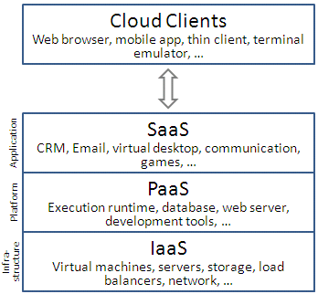
3. Cloud Platform as a Service (PaaS):
It's a service that lets clients maintain and develop applications without worrying about the underlying infrastructure.
In this service, the cloud vendor manages infrastructure, operating system, middleware, etc.
● Users-Developers
Examples: Windows Azure, Google App Engine .

Slide 9
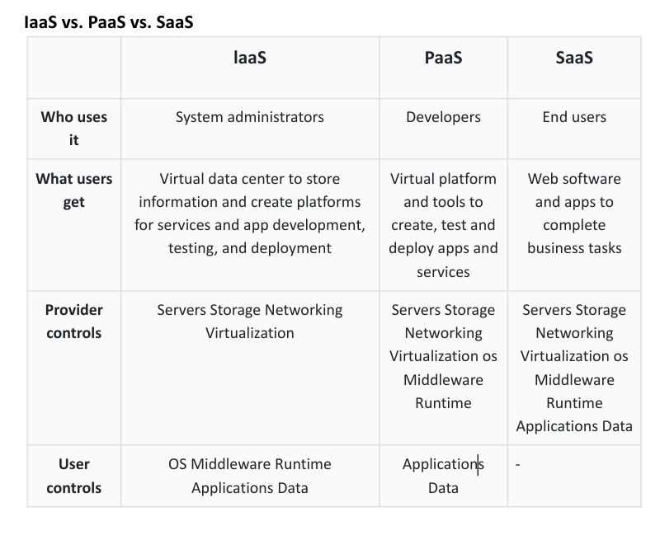

Slide 10
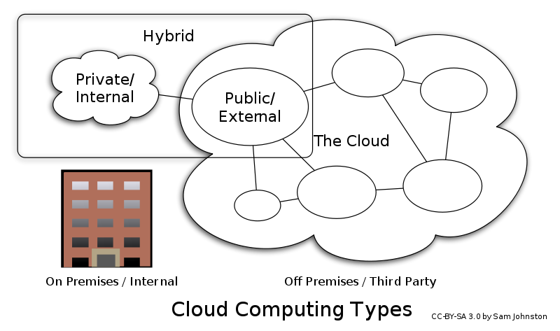

Slide 11
Cloud Types / Deployment Models
Private Cloud:
The cloud is operated solely for an organization. It may be managed by the organization or a third party and may exist on premise or off premise.
This type of cloud is similar to a public cloud, but the difference is that the infrastructure and requirements are reserved for just a single organization only. ● The resources are isolated and can’t be used by other organizations
Example: Amazon private cloud.
Public Cloud:
Services are dedicated to a single organization and hosted either on-premises or by a third-party provider.
Services are provided over the public internet and shared across multiple users.
Like: cloud vendor aka the business that sells its services to the general public.
Example: AWS, Microsoft Azure, VMware, OpenStack.

Slide 12
Community Cloud:
Services are dedicated to a single organization and hosted either on-premises or by a third-party provider.
Example: VMware, OpenStack.
Hybridge Cloud:
Services are provided over the public internet and shared across multiple users.
This is a combination of public cloud and private cloud. This is much more complex than public or private clouds. In this type of cloud
● The public cloud is used for non-critical tasks. ● The private cloud is used to carry out critical tasks.
Example: AWS, Microsoft Azure.

